Slide 1

Capstone Project
Banking Domine
Cherukuri Sai Chaitanya

Slide 2

Project Summary
The Project is about the marketing campaign conducted by the protugeuese banking institution
1. The marketing campaign is based on the phone calls to the customer
2. In this campaign, the customer will get the phone calls regarding the sales of the bank term deposit
3. Dataset has the customer, campaign and the outcome of the campaign recodes
4. In the dataset independent variable is showing the data of customer has subscribed the term deposit or not
5. The independent variable is a categorical variable
Objective
To predict if the customer will subscribe for the bank term deposit

Slide 3


Exploratory Data analysis (EDA)

Slide 4
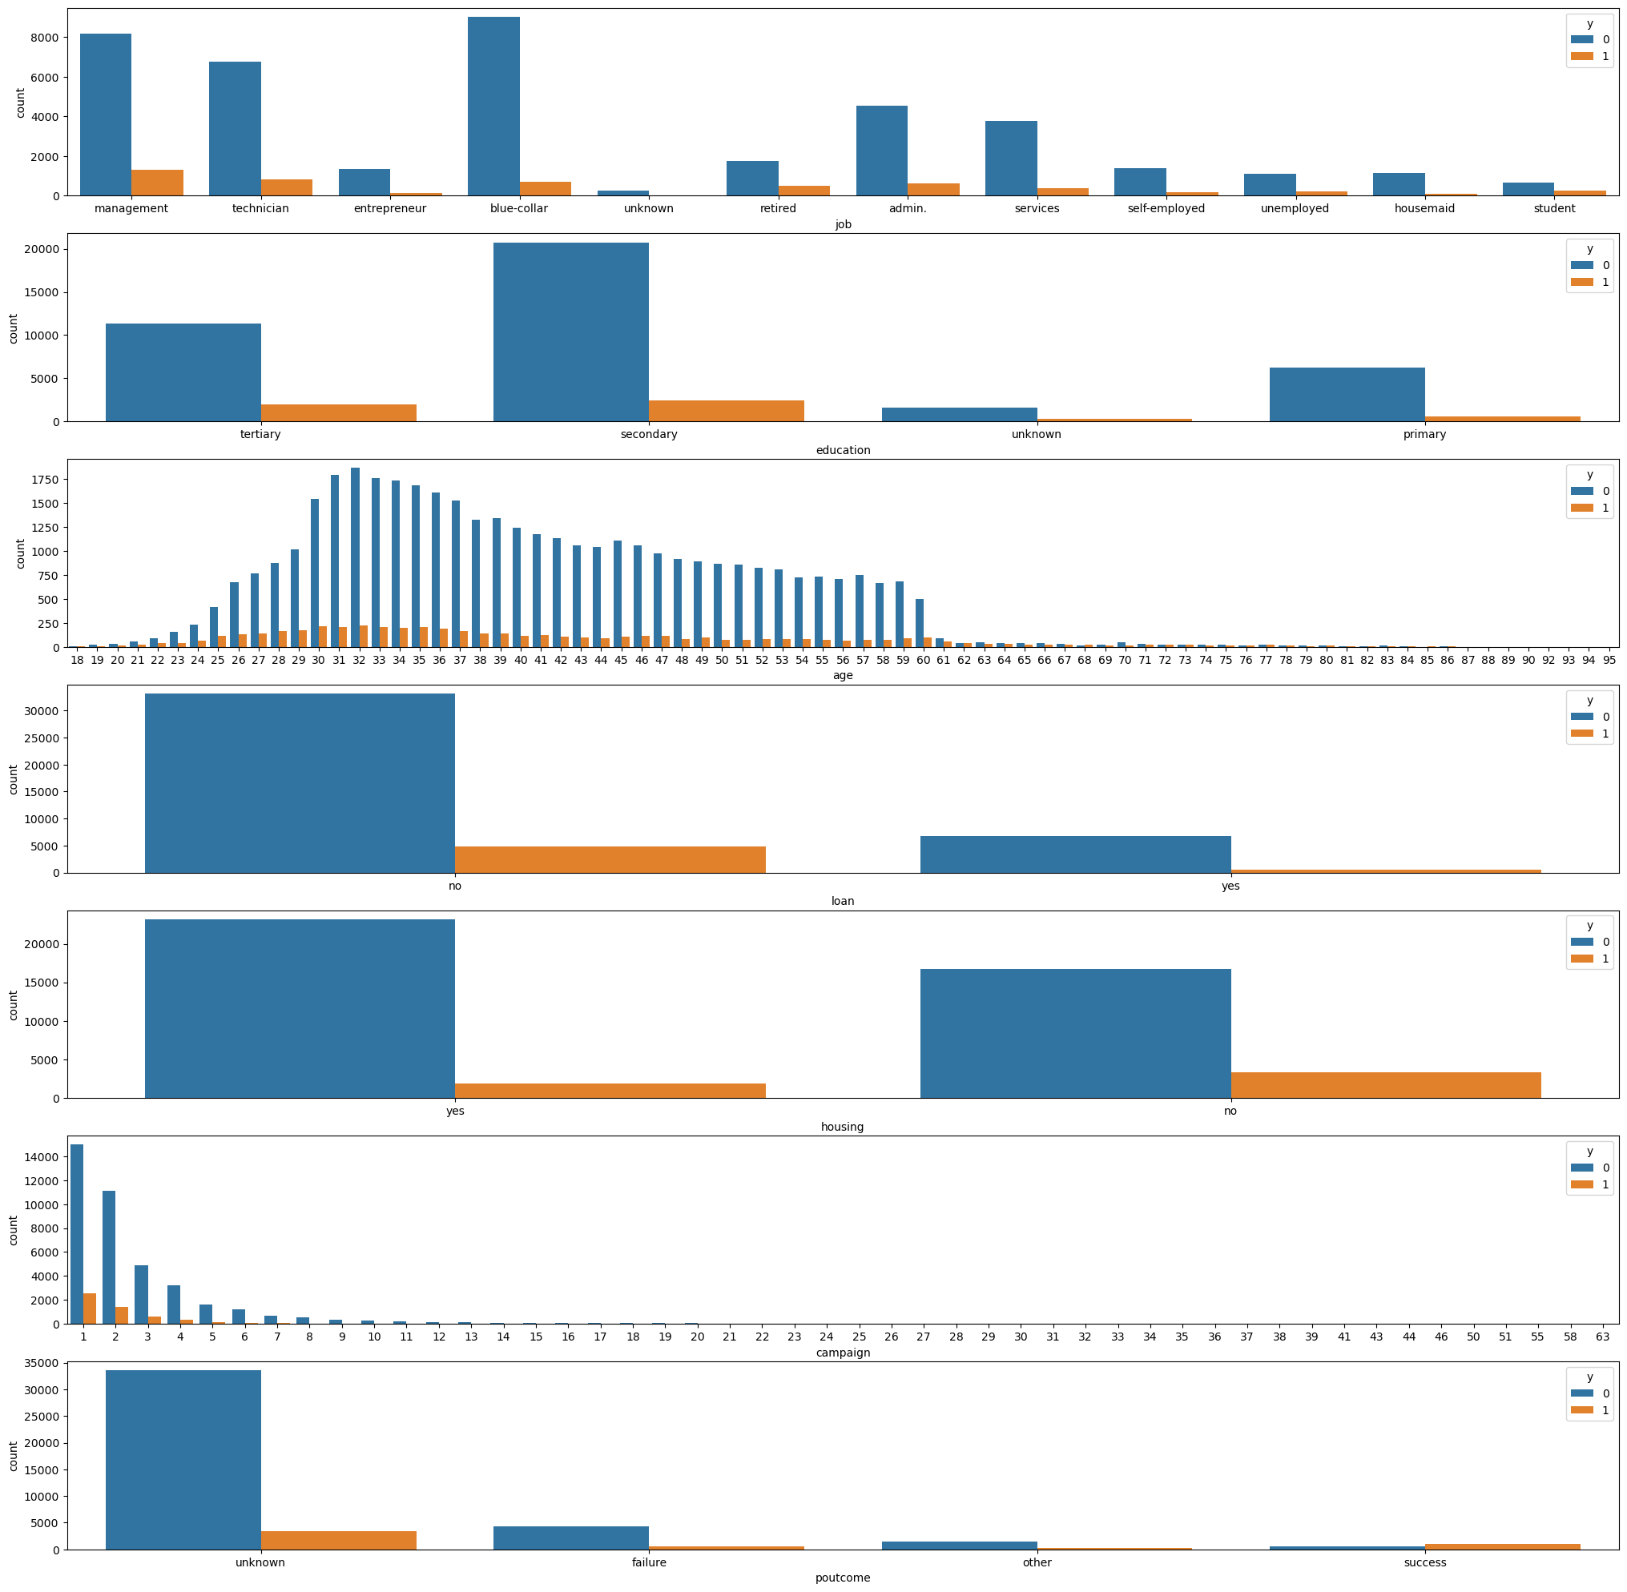

Analysis Outcomes
-Management Employees are subscribing for the bank term deposit more than other job roles
- Age around 32 to 35 has taken the term deposit high in number
- Number of contacts performed on the client is not effecting any impact on the term deposit subscription
- People with no personal loan and home loan are more tends to subscribe to term deposit
- People who has taken in the previous campaign are tend to take term deposit this campaign as well

Slide 5
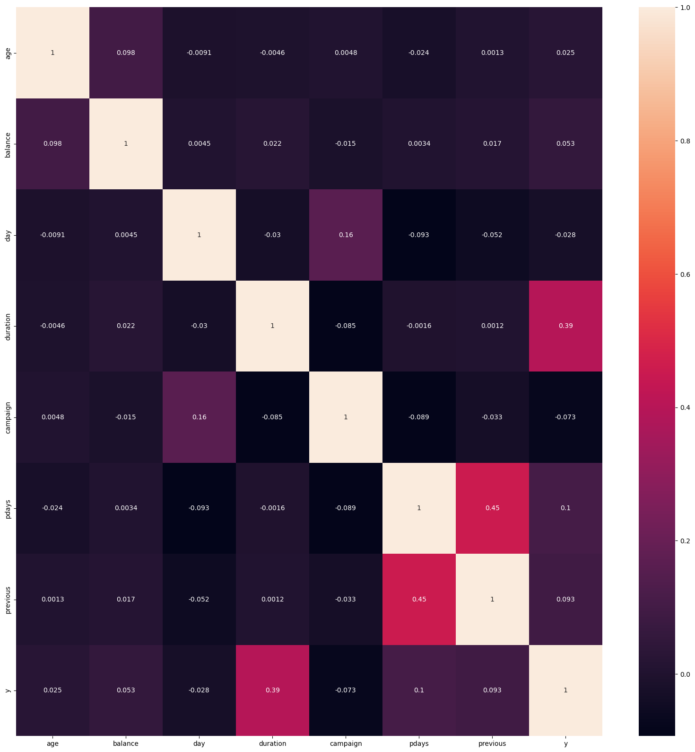
Correlation between the Duration & Y, Pdays & Previous column is high

Slide 6
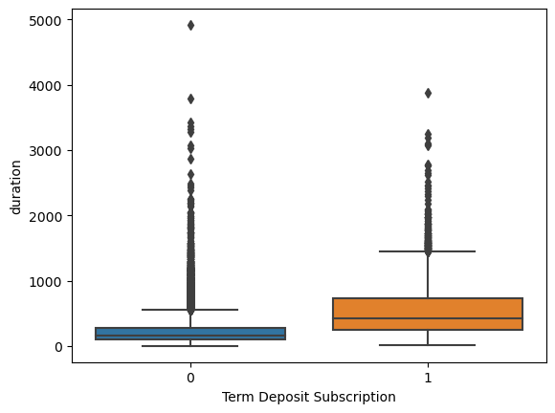
Duration and y variables has good correlation
Average call duration for the customer who has taken the term deposit is high
From the boxplot we understand, outliers are high for the duration and y
Due to these outlies we can't strongly tell if the call duration is high customer will subscribe to the term deposit

Slide 7

Machine Learning Model Training

Slide 8



Data Preprocessing
All the columns has been converted to the int type
Three different techniques are used to process the data
Scaling
REF technique
Principal Compound Analysis

Slide 9
Machin Learning Algorithms
Following Algorithms are trained to bring the better accuracy
Random Forest Classification
Logistic Regression
Bagging
Support Vector Classification(SVC)
K-Nearest Neighbor Classification(K-NN)
Randomize Search CV
Balanced Random Forest Classifier
SMOTE

Slide 10
Model Name | Accuracy | Accuracy_REF | Accuracy_PCA
LogisticRegression | 89.8 | 89.8 | 89.7
RandomForest | 90.4 | 90.2 | 90.0
SVC | 90.3 | 90.3 | 90.3
KNN | 89.2 | 89.4 | 89.2
RandomizesearchCV | 0 | 0 | 90.1
Bagging | 90.3 | 90.1 | 89.8
Balanced RandomFOrest Classifier | 83.4 | 0 | 0
SMOTE | 89.3 | 0 | 0
By training the different algorithms on the dataset, Random forest has the consistence accuracy score of around 90%
Accuracy score is not improving more that 90%
Random Forest model is the best fit as per the analysis

Slide 11
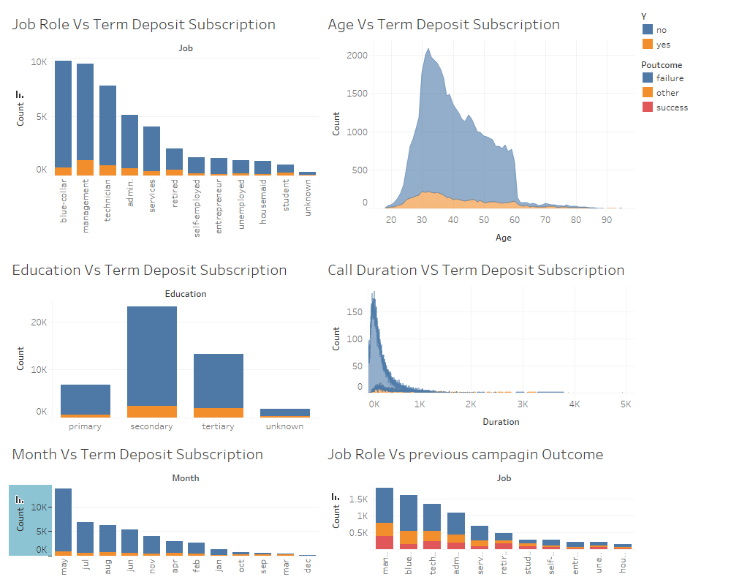
Data Analysis In Tableau

Slide 12

Thank You

